Slide 1
Bootstrap
A resampling method

Slide 2
Resampling
Resampling methods are an indispensable tool in modern statistics. They involve repeatedly drawing samples from a training set and refitting a model of interest on each sample in order to obtain additional information about the fitted model.
Most widely used resampling methods:
Cross validation (used to select model)
Bootstrap (used to quantify uncertainty)

Slide 3
Bootstrap - what do we use it for
Used to quantify the uncertainty/variability associated with a given estimator or statistical learning method by estimating the sampling distribution of an estimator
For example, it can provide an estimate of the standard error of a coefficient, or a confidence interval for that coefficient.

Slide 4
Bootstrap - how to measure uncertainty
Uncertainty: we train/fit our model on the available data and then use the model to predict response variable given new data.
How much confidence do we have in our predictions? (Confidence comes from successful repetitions.)
If given another set of training data, will our model/estimator change significantly?
Need new data to measure uncertainty.

Slide 5
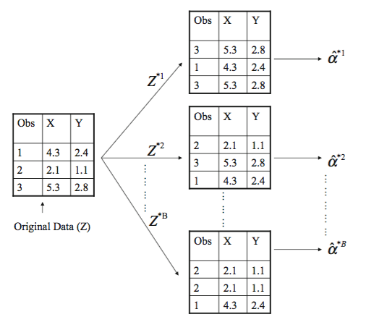
Bootstrap - how does it work
We create “bootstrap datasets” by repeatedly sampling observations from the original datasets with replacement (the same observation can occur more than once in the bootstrap data set)
Produce a new bootstrap estimate for α given each bootstrap dataset.
We can compute the summary statistics of these bootstrap estimates

Slide 6
Bootstrap - a trivial example in R
# Create one bootstrap dataset (index) from original data
index<-sample(1:nrow(data),nrow(data),replace=T)
# Produce bootstrap estimate given one bootstrap dataset
boot.fn=function(data,index){
model<-lm(mpg~horsepower, data=data, subset=index)
return(coef(model))
}
# Produce 1000 bootstrap estimates
alpha<-NULL
for (i in 1:1000){
ind<-sample(1:nrow(data),nrow(data),replace=T)
alpha<-rbind(alpha,boot.fn(data,ind))
}
mean(alpha)
sd(alpha)

